Slide 1
Oracle9i Object Features

Slide 2
Objectives
After completing this lesson, you should be able to do the following:
  Describe the Oracle9i scalar datatypes
  Describe object types and objects
  Describe object tables, object columns, and object views
  Describe the INSTEAD-OF triggers
  Describe object REFs
  Identify the display of objects in the Object Navigator
Notes:
Overview
Introduction
In this lesson, you will review certain object features of Oracle9i. This lesson also explains how objects are displayed in the Object Navigator.
Objectives
After completing this lesson, you should be able to do the following:
Describe the Oracle9i scalar datatypes
Describe object types and objects
Describe object tables, object columns, and object views
Describe the INSTEAD-OF triggers
Describe object REFs
Identify the display of objects in the Object Navigator

Slide 3
Oracle9i Scalar Datatypes
  Automatically converted:
    FLOAT
    NLS types
      NCHAR
      NVARCHAR2
  Unsupported:
    Timestamp
    Interval
Notes:
Oracle9i Datatypes
In Oracle Forms Builder, these datatypes are automatically converted to existing Forms item datatypes. Three new scalar datatypes were introduced with Oracle8i:
NCHAR stores fixed-length (blank-padded if necessary) NLS (National Language Support) character data.
NVARCHAR2 stores variable-length NLS character data.
FLOAT is a subtype of NUMBER. However, you cannot specify a scale for FLOAT variables. You can only specify a binary precision, which is the total number of binary digits.
NLS (National Language Support) Types in Oracle9i: In Oracle9i Database, data stored in columns of NCHAR or NVARCHAR2 datatypes are exclusively stored in Unicode, regardless of the database character set. This enables users to store Unicode in a database that may not use Unicode as the database character set. Oracle9i Database supports two Unicode encodings for the Unicode datatypes: AL16UTF16 and UTF8 .
With NLS, number and date formats adapt automatically to the language conventions specified for a user session. Users around the world can interact with the Oracle server in their native languages. NLS is discussed in Oracle9i Globalization Support Guide.
Unsupported: Timestamp and interval datatypes (new with Oracle9i).

Slide 4
Object Types
Attributes
Ship
ORDER
po_no
custinfo
line_items
amount
Cancel
Check status
Hold
Methods
Notes:
Object Types
An object type is a user-defined composite datatype. Oracle9i requires enough knowledge of a user-defined datatype to interact with it. Thus, in some sense an object type is similar to a record type, and in some sense it is similar to a package.
An object type must have one or more attributes and can contain methods.
Attributes: An object type is similar to a record type in that it is declared to be composed of one or more subparts that are of predefined datatypes. Record types call these subparts fields, but object types call them attributes. Attributes define the object structure.
CREATE TYPE address_type AS OBJECT
(address VARCHAR2(30),
city VARCHAR2(15),
state CHAR(2),
zip CHAR(5));
CREATE TYPE phone_type AS OBJECT
(country NUMBER(2),
area NUMBER(4),
phone NUMBER(9));

Slide 5
Notes:
Object Types (continued)
Just as the fields of a record type can be of other record types, the attributes of an object type can be of other object types. Such an object type is called nested.
CREATE TYPE address_and_phone_type AS OBJECT
(address address_type,
phone phone_type);
Object types are like record types in another sense: Both of them must be declared as types before the actual object or record can be declared.
Methods
An object type is also similar to a package. Once an object is declared, its attributes are similar to package variables. Like packages, object types can contain procedures and functions. In object types, these subprograms are known as methods. A method describes the behavior of an object type.
Like packages, object types can be declared in two parts: a specification and a body. As with package variables, attributes declared in the object type specification are public and those declared in the body are private. As with package subprograms, all methods are defined in the package body, but only those whose specification appears in the object type specification are public methods.
Here is an example of an object type:
CREATE TYPE dept_type AS OBJECT
(dept_id NUMBER(2),
dname VARCHAR2(14),
loc VARCHAR2(3),
MEMBER PROCEDURE set_dept_id (d_id NUMBER),
PRAGMA RESTRICT_REFERENCES (set_dept_id,
RNDS,WNDS,RNPS,WNPS),
MEMBER FUNCTION get_dept_id RETURN NUMBER,
PRAGMA RESTRICT_REFERENCES (get_dept_id,
RNDS,WNDS,RNPS,WNPS));
CREATE TYPE BODY dept_type AS
MEMBER PROCEDURE set_dept_id (d_id NUMBER)
IS
BEGIN
dept_id := d_id;
END;
MEMBER FUNCTION get_dept_id
RETURN NUMBER
IS
BEGIN
RETURN (dept_id);
END;
END;

Slide 6

Object Tables
Object table based on object type
Notes:
Creating Oracle9i Objects
Once you have declared an object type, you can create objects based on the type.
Object Tables
One way to create an object is to create a table whose rows are objects of that object type. Here is an example of an object table declaration:
CREATE TABLE o_dept OF dept_type;
SQL and PL/SQL treat object tables very similarly to relational tables, with the attribute of the object corresponding to the columns of the table. But there are significant differences. The most important difference is that rows in an object table are assigned object IDs (OIDs) and can be referenced using a REF type.
Note: REF types are reviewed later.
Instructor Note
At this point, review the fact that object types are not themselves objects. They are only blueprints for objects. The term object can be confusing because Oracle uses the term to refer to constructs within the database—for example, tables, views, procedures, and so on. This is a completely different usage. Make certain that your students are aware of the overloading of this term.

Slide 7
Object Columns
Object column based on object type
Notes:
Object Columns
Another construct that can be based on an object type is an object column in a relational table. Here is an example of a relational table creation statement with an object column:
CREATE TABLE o_customer (
custid NUMBER (6) NOT NULL,
name VARCHAR2 (45),
repid NUMBER (4) NOT NULL,
creditlimit NUMBER (9,2),
address address_type,
phone phone_type);
In the object table, the rows of a table are objects. In a relational table with an object column, the column is an object. The table will usually have standard columns, as well as one or more object columns.
Object columns are not assigned object IDs (OIDs) and therefore cannot be referenced using object REF values.
Note: Object REFs are reviewed later in this section.

Slide 8
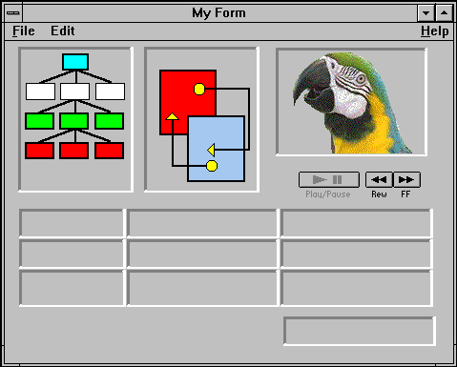
Object Views
Object-oriented
application
Object
view
Relational
table
Object views based on object types
Notes:
Object Views
Often, the most difficult part of adopting a new technology is the conversion process itself. For example, a large enterprise might have several applications accessing the same data stored in relational tables. If such an enterprise decided to start using object-relational technology, the enterprise would not convert all of the applications at once. It would convert the applications one at a time.
That presents a problem. The applications that have been converted need the data stored as objects, whereas the applications that have not been converted need the data stored in relational tables.
This dilemma is addressed by object views. Like all views, an object view transforms the way a table appears to a user, without changing the actual structure of the table. Object views make relational tables look like object tables. This allows the developers to postpone converting the data from relational structures to object-relational structures until after all of the applications have been converted. During the conversion process, the object-relational applications can operate against the object view; the relational applications can continue to operate against the relational tables.
Objects accessed through object views are assigned object IDs (OIDs), and can be referenced using object REFs.

Slide 9
Notes:
Object Views
Note: Object REFs are reviewed later in this section.
Here is an example of an object view creation statement:
CREATE VIEW emp_view OF emp_type
WITH OBJECT OID (eno)
AS
SELECT e.empno, e.ename, e.sal, e.job
FROM emp e;

Slide 10
INSTEAD-OF Triggers
DECLARE
BEGIN
EXCEPTION
END;
Nonupdatable
view
INSTEAD-OF
Trigger
Notes:
Object Views (continued)
INSTEAD-OF Triggers: INSTEAD-OF triggers provide a transparent way of modifying views that cannot be modified directly through SQL DML statements (INSERT, UPDATE, and DELETE).
These triggers are called INSTEAD-OF triggers because, unlike other types of triggers, the Oracle server fires the trigger instead of executing the triggering statement. The trigger performs update, insert, or delete operations directly on the underlying tables.
Users write normal INSERT, DELETE, and UPDATE statements against the view, and the INSTEAD-OF trigger works invisibly in the background to make the right actions take place.
INSTEAD-OF triggers are activated for each row.
Note: Although INSTEAD-OF triggers can be used with any view, they are typically needed with object views.

Slide 11
References to Objects
OID
REF
Notes:
Referencing Objects
Introduction
In relational databases, primary key values are used to uniquely identify records. In object-relational databases, OIDs provide an alternative method.
When a row in an object table or object view is created, it is automatically assigned a unique identifier called an object ID (OID).
Object REFs
With relational tables, you can associate two records by storing the primary key of one record in one of the columns (the foreign key column) of another.
In a similar way, you can associate a row in a relational table to an object by storing the OID of an object in a column of a relational table.
You can associate two objects by storing the OID of one object in an attribute of another. The stored copy of the OID then becomes a pointer, or reference (REF), to the original object. The attribute or column that holds the OID is of datatype REF.

Slide 12
Notes:
Referencing Objects (continued)
Note: Object columns are not assigned OIDs and cannot be pointed to by a REF.
Here is an example of a table declaration that includes a column with a REF datatype:
CREATE TABLE o_emp
( empno NUMBER(4) NOT NULL,
ename VARCHAR2(10),
job VARCHAR2(10),
mgr NUMBER(4),
hiredate DATE,
sal NUMBER(7,2),
comm NUMBER(7,2),
dept REF dept_type SCOPE IS o_dept) ;
Note: The REF is scoped here to restrict the reference to a single table, O_DEPT. The object itself is not stored in the table, only the OID value for the object.

Slide 13
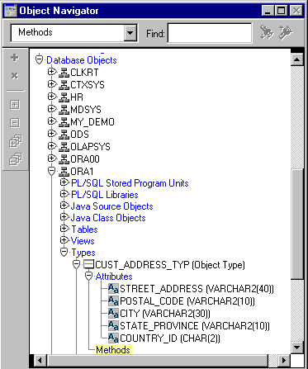
Object Types in Object Navigator
Notes:
Displaying Oracle9i Objects in the Object Navigator
The Object Navigator lists declared types in the “Database Objects” section, along with tables, views, and other Oracle objects.
Object Types
Both the attributes and the methods are listed under each type. Also, the nested types within a type are displayed in an indented sublevel.
This convention is used for nested object and object type displays throughout Oracle Developer.

Slide 14
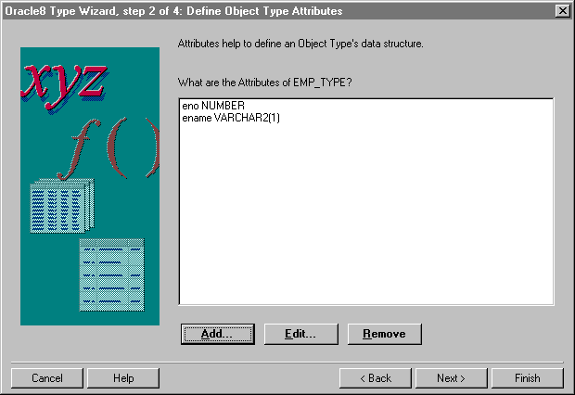
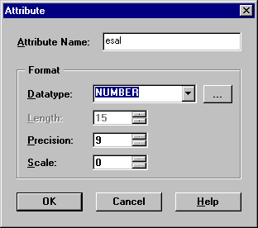
Object Type Wizard
Notes:
Oracle8 Type Wizard
Object types can be created using the Oracle8 Type Wizard. The wizard allows you to define the attributes and methods. You invoke the Oracle8 Type Wizard from Forms Builder by selecting the Types node in a schema under Database Objects, then clicking the Create icon.
Note: The Type Wizard is called Oracle8 Type Wizard, even though it is invoked from Oracle9i Forms connected to an Oracle9i database.

Slide 15
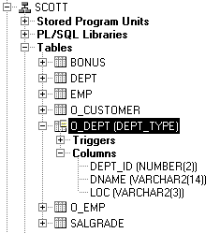
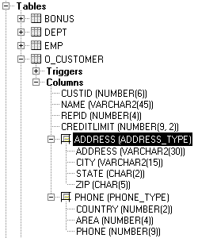
Object Tables and Columns in Object Navigator
Notes:
Object Tables and Columns
Object Tables
Object tables are displayed like relational tables, with the attributes of the object displayed like columns in a relational table. Also, the object table type name is displayed in parentheses after the name of the object table.
Object Columns
Object columns are displayed with the object type in parentheses after the column name and with the attributes of the type indented underneath the column name.

Slide 16
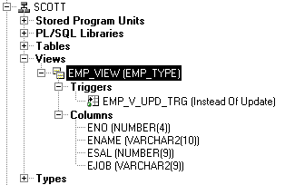
Object Views in Object Navigator
Notes:
Object Views
Object views are displayed like any other view, except that the object type on which they are based is written in parentheses after the view name.

Slide 17
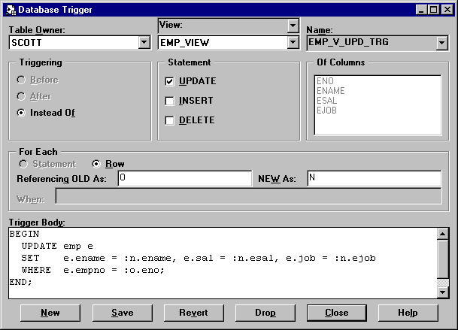
INSTEAD-OF Trigger Dialog Box
Notes:
Object Views
Object views are displayed like any other view, except that the object type on which they are based is written in parentheses after the view name.
INSTEAD-OF Triggers: INSTEAD-OF database triggers can now be created through the trigger creation dialog box, just like any other database trigger.
INSTEAD-OF INSERT, UPDATE, and DELETE triggers allow you to directly insert, update, and delete against object views. They can also be used with any other type of view that does not allow direct DML.
When a view has an INSTEAD-OF trigger, the code in the trigger is executed in place of the triggering DML code.
Reference: For more information about INSTEAD-OF triggers, see Oracle9i Application Developer's Guide – Fundamentals or Oracle9i Database Concepts.

Slide 18
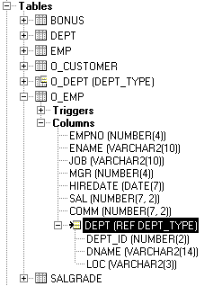
Object REFs in Object Navigator
Notes:
Object REFs
Object types that contain attributes of type REF, and relational tables that have columns of type REF, display the keyword REF before the name of the object type that is being referenced.
The attributes of the referenced object type are displayed indented under the column or attribute.

Slide 19
Summary
  Oracle8 introduced three scalar datatypes.
  Objects and object types allow representation of complex data.
  Three kinds of objects are object tables, object columns, and object views.

Slide 20
Summary
  INSTEAD-OF triggers allow DML on object views.
  Object REFs store the object identifier of certain types of objects.
  The Object Navigator can display certain types of objects.
Notes:
Summary
Oracle9i Datatypes
Oracle8 introduced three scalar datatypes and composite datatypes, such as object types, that are also available in Oracle9i.
Objects
Three kinds of objects are object tables, object columns, and object views.
INSTEAD-OF triggers allow DML on object views.
Object REFs store the object identifier of certain types of objects.
Oracle9i Objects in the Object Navigator
The Object Navigator can display certain types of objects.

